Slide 1
ETERNAL REALMS
SENIOR DATA ENGINEER CHALLENGE · DUSKMIRE STUDIOS
Data platform and cheat investigation
9.65 million game events, 7 data problems fixed, 13 cheat rules, 5 cheaters caught, every finding traced back to its source events.
Daniel Chidi · October 2026
Notes:
Introducing myself in one sentence. Then: Duskmire asked for three things: a data platform built from their beta snapshot, proof that it supports their reports, and an answer to who cheated and how. I'll walk through how I handled the data, what I found, and then show it running live

Slide 2

ABOUT ME
Daniel Chidi
Data analyst · Calgary, AB
Education
Data Analytics post-diploma certificate,SAIT · Business Administration Management diploma, SAIT (2026)
Experience
6+ years of experience supporting telecom,broadband,customer snslytics, operational reporting and business intelligence initiatives, skilled in Python, SQL,Excel, Power BI , Microsoft fabric, data cleaning, exploratory analysis.
Tools
SQL, Python, R, Excel ,Power BI,Kafka, snowflake, spark,Fabric
Portfolio: github.com/Danny2056
Notes:
Keep this to 20 seconds: background in business and operations, now data analytics. The point to land: I care about turning messy operational data into decisions.

Slide 3
THE BRIEF
Three things Duskmire asked for
01
A data platform
Ingest the read-only snapshot into our own stack and model it for analysis.
02
Report-ready
Prove the model supports every player and economy report in the brief, with peer percentiles.
03
Who cheated?
Which accounts, which cheats, and why each counts as cheating, with lineage to source events.
The rulebook is the authority. When the data disagrees with it, either the data is wrong or someone broke the game.
Notes:
Frame the whole talk: platform, reports, cheaters. Then the principle that drove every decision: the rulebook decides, so I first had to prove the data was trustworthy.

Slide 4
AT A GLANCE
Prove the data first, then let the rulebook decide
1
Process
Copied 9.65 million events and reconciled them, cleaned the data, turned the rulebook into 13 automatic checks and built a star schema for every report.
2
Data problems
7 found and fixed: 47,733 duplicates, 9,615 lost events, one server clock 5 hours behind (927,920 events), plus missing fields, fake IDs and scrambled numbers.
3
Cheaters
5 coordinated accounts, nobody else. Burst damage killed the final boss in 13 s (honest best: 176 s) and 18 players, plus item duplication, equip stacking, a speed hack and gear above level.
4
Fix and watch
Patch damage rate, trade ownership, equip slots and movement. Watch two anomalies: no deaths in 8,137 boss fights, and 99.9% of new gold never leaves.
Notes:
This is the whole story in one slide. If time is short, this slide plus the demo covers the brief.

Slide 5
THE PLATFORM
One pipeline, rebuilt from scratch on a laptop
Snapshot
Postgres in Docker, read only
Raw
Parquet, exact copy, row counts reconciled
Staging
Deduplicated, clock fixed, values repaired
Warehouse
Data quality, cheat rules, star schema in DuckDB
9,650,208
40
~15 min
events ingested and reconciled
SQL models, one table each
end to end, Python + DuckDB
python ingestion\extract.py → python transform\run.py → python reports\run_reports.py
Notes:
Everything reruns from the snapshot with three commands. Row counts are reconciled at ingestion, so nothing downstream is built on a partial copy.

Slide 6
DATA QUALITY FIRST
Seven problems fixed before looking for cheaters
Check | What went wrong | Rows | Fix
DQ-1 | Same event delivered twice | 47,733 | Kept one copy per event id
DQ-2 | Events lost in delivery | 9,615 | Listed, so never mistaken for cheats
DQ-3 | Shard-04 clock 5 hours off | 927,920 | Timestamps corrected and flagged
DQ-4 | Missing fields, empty bodies | ~0.1–1% | Left unknown, recovered if certain
DQ-5 | Placeholder and fake IDs | 7,495 | Treated as unknown, excluded
DQ-6 | Corrupted numbers | 4,739 | Bit-flips repaired, garbage nulled
DQ-7 | Level-ups to “level 0” | 36 | Treated as unknown
Notes:
Lead with DQ-2: lost events are listed explicitly so a missing message can never be read as a cheat. DQ-3 gets its own slide next.

Slide 7
DQ-3 · THE HIDDEN TRAP
One server’s clock ran 5 hours behind
0.7 s
Delay between an event and its receipt, before the 7 Sep restart
18,000 s
The same delay after it, from message 6,736,768 onwards
Shard-04 restarted on Chicago time instead of UTC. It runs the endgame zones, so every speed and cooldown check there would have been wrong. 927,920 events were moved forward 5 hours; the correction is stored as data and the original timestamp is kept.
Notes:
Without this fix, honest endgame players would have looked like speed hackers. This is why the data had to be proven before any accusation.

Slide 8
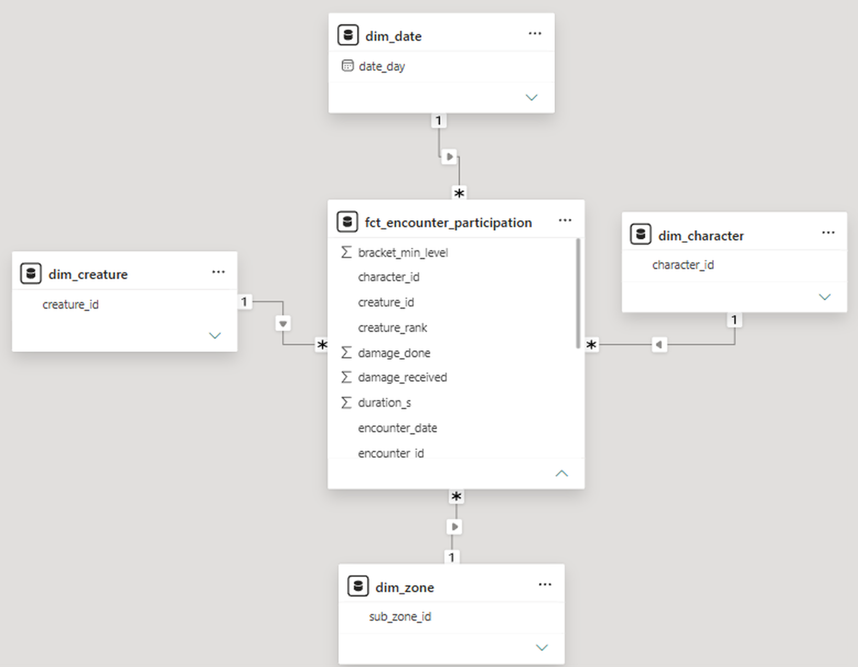
DATA MODEL
A star schema behind every report
10 FACTS
sessions · fights per character · creature kills · deaths · XP · loot · gold ledger · transactions · gear · sub-zone activity
6 DIMENSIONS
date · character · character level over time · zone and sub-zone · item template · creature
Level is tracked over time. Peers are the same class and 10-level bracket at the moment of the event, not today.
Gold is a signed ledger. Each movement is a source, a sink or a transfer, so gold in vs out is one sum.
Cheaters are excluded from peer groups, so percentiles stay fair for honest players.
Grain: one row per character per fight. Plus a cheats schema: 13 rules, every violation linked to raw events.
Notes:
I Showed one star rather than all 16 tables: the encounter fact and the four shared dimensions it joins to. Every report filters through the same dimensions, which is what makes the peer comparisons consistent.

Slide 9
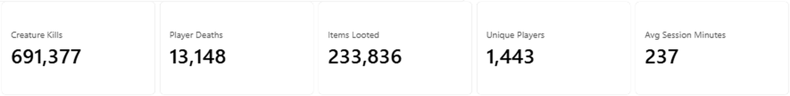
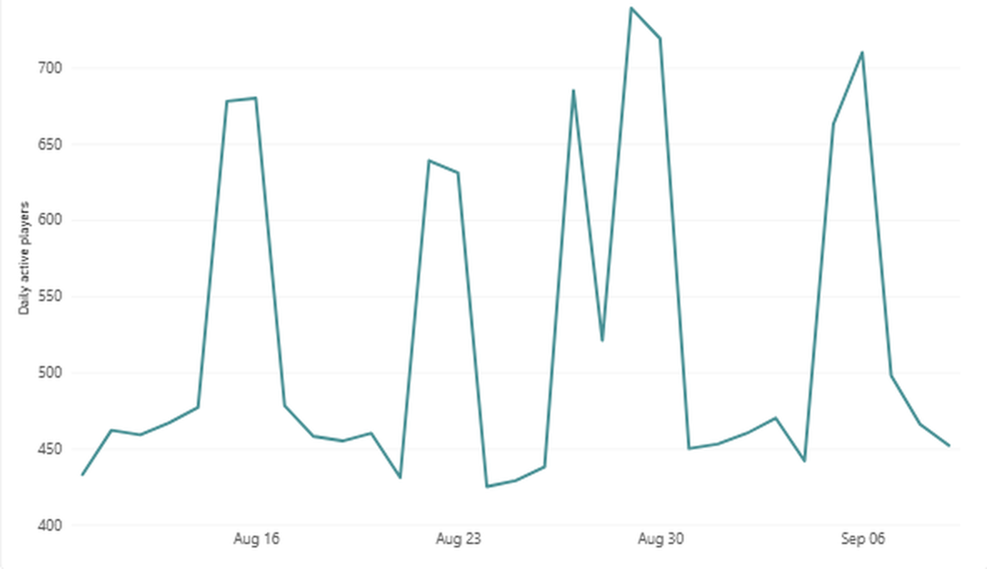
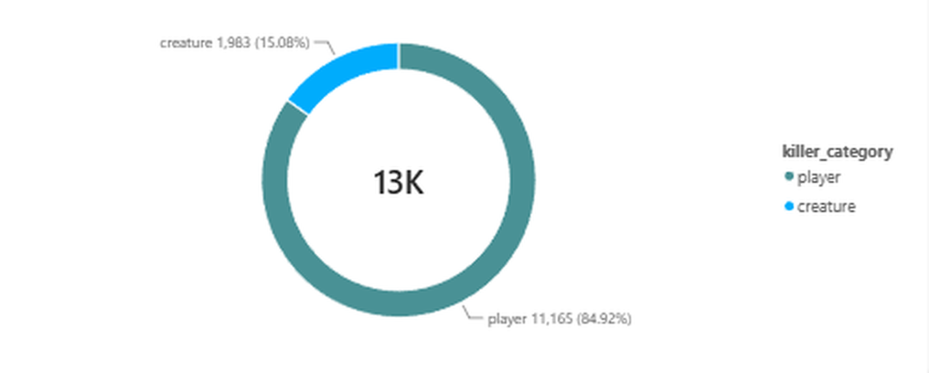
POWER BI · PLAYER REPORTS
About 450 players a day, with weekend peaks near 700
Daily active players (10 Sep excluded: partial day)
Player deaths by killer category
Weekly pattern: weekend peaks run about 50% above weekdays.
Deaths: 85% to other players, 15% to creatures, none to bosses.
Notes:
This is the Overview page of the Power BI report, built on the same star schema. Unique players is the distinct count across the whole window; the line shows daily actives. The last, partial day is filtered out.

Slide 10
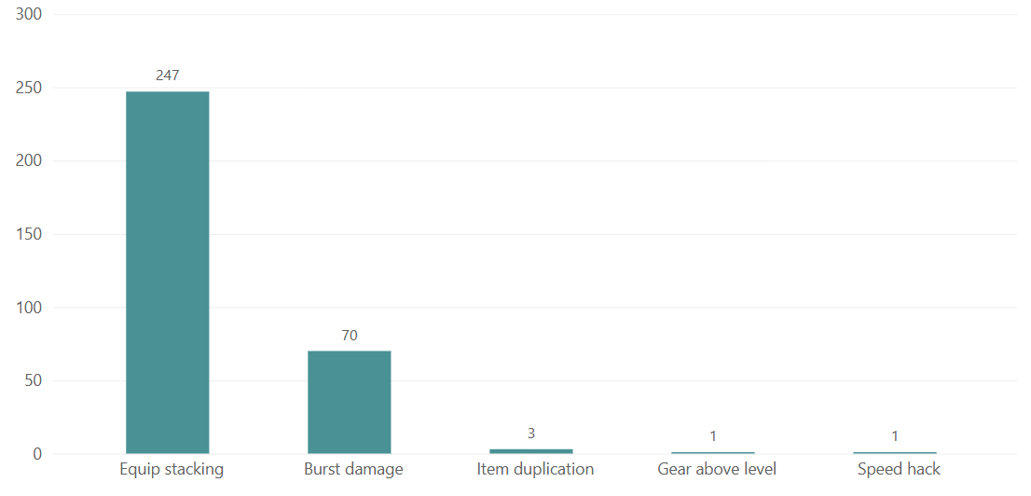
CHEAT DETECTION
13 rulebook rules, checked for every player
13
5
322
5
Rule | Broken | Hits | Players
R01 | Burst damage | 70 | 5
R02 | Item duplication | 3 | 1
R03 | Equip stacking | 247 | 5
R04 | Speed hack | 1 | 1
R05 | Gear above level | 1 | 1
R06–R13 | Damage cap, cooldowns, amulet, soulbound, trades, transport, hubs, XP | 0 | 0
rules
rules broken
violations
characters
Every violation stores the raw event IDs that prove it. One lost message can fake one signal, so a cheater must break a serious rule or three different rules.
Notes:
Chart from the Power BI Cheaters page. Equip stacking and burst damage are 98% of all violations. Eight rules found nothing, which matters: the checks are not trigger-happy.

Slide 11
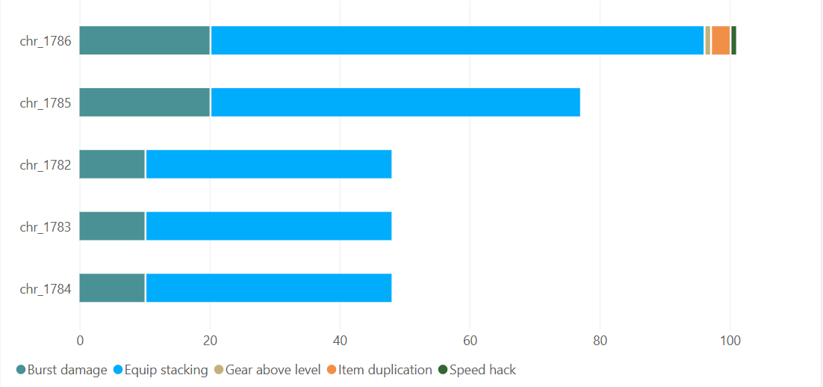
THE CHEATERS
Five accounts, created 12 minutes apart
Account | Character | Class | Created | Violations
acc_1013 | chr_1782 | Warrior | 13 Aug 20:50 | 48
acc_1015 | chr_1784 | Mage | 13 Aug 20:54 | 48
acc_1014 | chr_1783 | Paladin | 13 Aug 20:55 | 48
acc_1016 | chr_1785 | Rogue | 13 Aug 20:56 | 77
acc_1017 | chr_1786 | Warlock | 13 Aug 21:02 | 101
One character per account, all Wildbound, always in the same 5-person party.
All five reached level 70 on 22 Aug, cheated on 22, 25 and 26 August, then never logged in again.
Only 20% of new characters reach level 70 at all.
Notes:
Chart from Power BI: every cheater used burst damage and equip stacking; chr_1786 alone added item duplication, the speed hack and gear above level.

Slide 12
MAIN EXPLOIT · BURST DAMAGE
20 hits in the same instant
13 s
Their kill of the final boss, Archon Vexmoor, twice
176 s
The fastest honest kill in 766 attempts (typical: 295 s)
18
Players killed with a single burst each
The rules allow one ability every 1.5 seconds. Across 1.3 million damage records, exactly 70 moments have more than one hit at once, always 20, and all 70 belong to these five. One burst is about 11,000 damage; a level-70 character has at most about 4,200 health.
Notes:
This is the headline exploit. The server limits ability uses but accepts any number of hits at once.

Slide 13
SECOND EXPLOIT · ITEM DUPLICATION
One sword, given away four times
25 Aug (UTC) | Event in the Thornhold auction house
21:39:01 | chr_1786 buys itm_0113674, a Stormrender Blade, for 5,805 gold
21:39:09 | chr_1786 trades it to chr_1782
21:39:24 | chr_1786 trades the same sword to chr_1783
21:39:52 | chr_1786 trades the same sword to chr_1784
21:40:09 | chr_1786 trades the same sword to chr_1785
21:40:54 | All five equip it, about 40 times each in seconds (equip stacking)
The only case in 3,563 item trades. Both sides of all four trades are recorded, so lost messages cannot explain it.
Notes:
One item, four recipients in about a minute. The game never checked that the giver still owned the sword.

Slide 14
WORST OFFENDER · CHR_1786
Thirteen days from new account to killing spree
When (UTC) | What happened
13 Aug 21:02 | Created; joins the group’s party 11 minutes later
15 Aug 19:03 | Equips a level-52 sword at level 32
22 Aug 18:04 | Buys gear, equips it 22 times in 6 seconds
22 Aug 18:09 | Walks Red Mesa to Ashen Vale in 52 s (minimum 434 s)
22 Aug 18:10 | Kills player chr_1118 with one 20-hit burst, teleports home, logs off
25 Aug 21:39 | Duplicates a sword to all four teammates
25 Aug 22:03 | The five kill Archon Vexmoor in 13 seconds
26 Aug 21:12 | Kill him again, 11.5 h after patch 2.1 improved his loot
26 Aug 21:30 | Kills 9 players in 17 minutes (chr_1785 kills 8 more)
26 Aug 22:14 | Last event; none of the five plays again
Notes:
Walk the escalation: gear above level, then equip stacking, the speed hack, the first burst kill, duplication, the boss kills, then the PvP spree and exit.

Slide 15
RECOMMENDATION
Patch these four mechanics, in this order
1 Damage rate limit
The server limits ability uses, not hits. Enforce one hit per use and the 1.5 s global cooldown on damage itself.
Stops burst damage · 70 violations, 18 kills
2 Trade ownership
Check the giver still owns the item and transfer it in one atomic step.
Stops item duplication
3 Equip slots
Reject an equip into a filled slot unless it is emptied in the same step; rate-limit equips.
Stops equip stacking · 247 violations
4 Movement
Validate zone transitions on the server against walking speed.
Stops the speed hack
Notes:
Ordered by damage done burst damage killed players and the final boss, so it comes first.

Slide 16
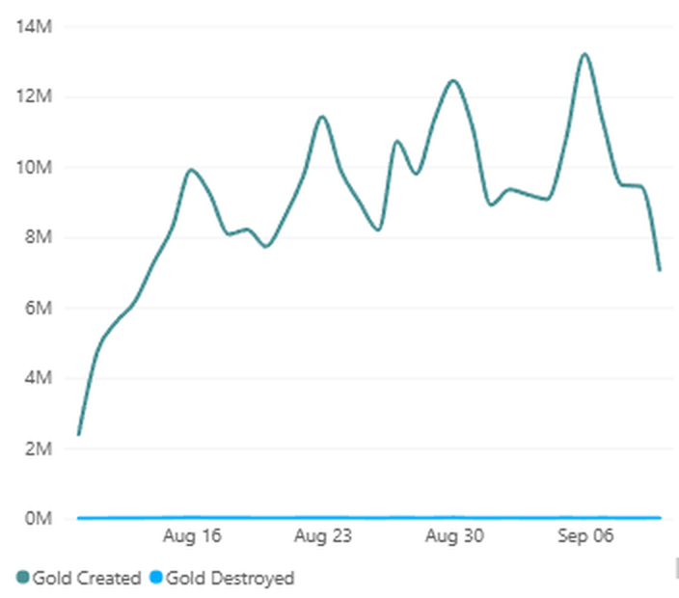
GAME ANOMALIES, NOT CHEATING
Three things that look wrong for every player
0
99.9%
3–4×
deaths to bosses
of new gold stays
creature damage
In 8,137 boss fights nobody died, even after taking up to 39 times their maximum health.
287.6 M gold entered the economy; only 0.38 M left through the auction cut.
In fights a player loses, creatures deal 3 to 4 times their stated damage.
Player deaths by killer · no boss slice at all
Gold created vs destroyed per day
Also
Weekends bring about 50% more players, and ferry use fell about 90% once the 6-second Waygate arrived in 2.1.
Notes:
Both charts are from Power BI. The donut has no boss slice because bosses killed nobody. The gold-destroyed line sits on zero while gold created runs at millions a day.

Slide 17
LIVE DEMO
From snapshot to reports in three commands
python ingestion\extract.py
python transform\run.py
python reports\run_reports.py
WHAT I WILL SHOW
1
Rule results: 13 rules, 5 broken, 8 clean
2
The five cheaters and their violations
3
Lineage: violation 23 traced to the raw delivery file
About 15 minutes end to end, so the demo starts from the finished warehouse and reruns the reports live.
4
Player 360 and the peer-percentile sentence
5
Gold flow and the boss-deaths anomaly
6
Power BI: Overview, Cheaters and Economy pages
Notes:
Have the warehouse already built. Run run_reports.py, open the lineage query for violation 23, then I switched to Power Bi

Slide 18
PRODUCTION ON AWS
Every local piece has a managed equivalent
Local | AWS
Postgres snapshot | Kinesis Data Streams for events, RDS for game state
extract.py | Data Firehose and DMS, landing Parquet in S3
DuckDB warehouse | S3 with Apache Iceberg tables, queried by Athena
SQL models + run.py | dbt on Athena, scheduled by Amazon MWAA
Cheat rules | Same SQL in batch; Flink for burst damage in seconds
Report queries | Athena views behind QuickSight or Power BI
Changes for production: incremental loads, automated clock-skew and lost-event alarms, and alerts on new high-severity violations.
Notes:
Diagram is in docs aws-architecture.md. Streaming matters only for burst damage, where minutes of delay mean more dead players.

Slide 19
IN SUMMARY
Proven data, caught cheaters, a platform that reruns
Data
7 problems proven, fixed and measured before any accusation.
Cheaters
5 coordinated accounts, 5 exploits, every finding traced to source.
Platform
Star schema, 15 report queries and a Power BI report, rebuilt from scratch in ~15 minutes.
Questions?
github.com/Danny2056/eternal-realms-solution

